Slide 1
TRANSFORM & cONQUER
Heaps and Heapsort

Slide 2
Overview
Binary Search Tree Traversal
AVL tree (Balanced Binary Tree)
Heaps and Heapsort

Slide 3
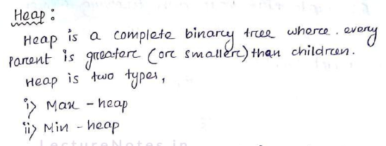
Heap (also termed as Binary Heap)
A special tree-based data structure that satisfies the heap property
Heap properties as follows:
It has to be a complete binary tree
It has to have any of the following properties”
Parent >= children (MAX HEAP)
Parent <= children (MIN HEAP)

Slide 4
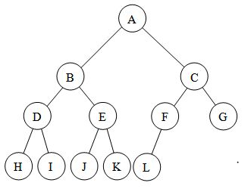
Complete Binary tree
A complete binary tree is a binary tree in which every level, except possibly the last is, filled, and all nodes are as far left as possible.

Slide 5

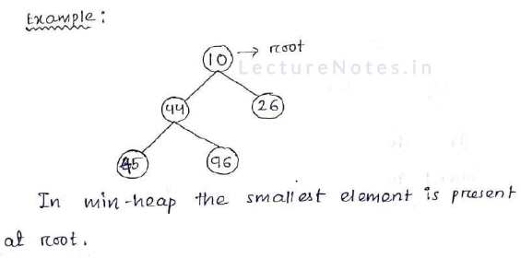
Min Heap

Slide 6

Heap Building
For, the given array Arr[] = { 2, 5, 4, 8, 9, 10, 11}

Slide 7

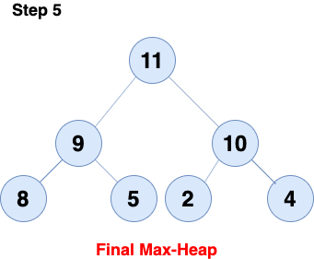

Slide 8


For, the max-heap Arr[] = { 11, 9, 10, 8, 5, 2, 4}

Slide 9



Slide 10



Slide 11
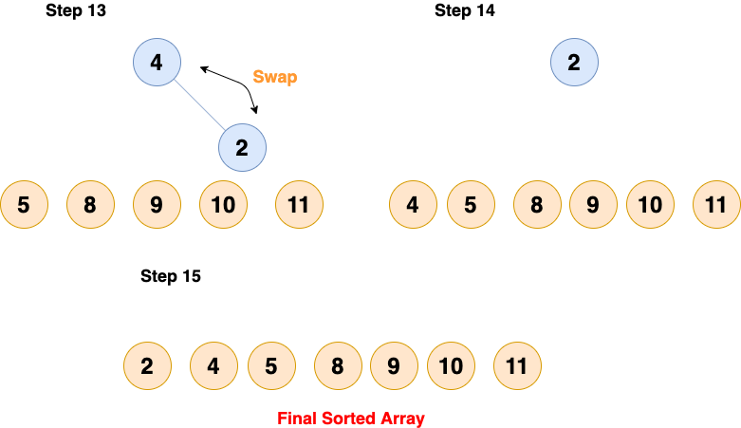

Slide 12
T(Heap Sort) = T(build Heap) + (N-1)*T(down_heapify)
= O(N) + (N-1)*O(logN)
= O(N) + O(NlogN)
= O(NlogN)

Slide 13
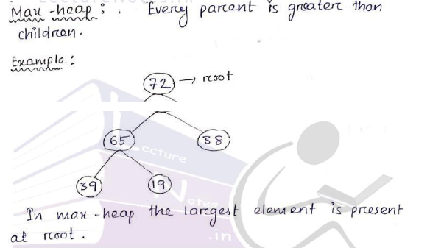
Max Heap

Slide 14
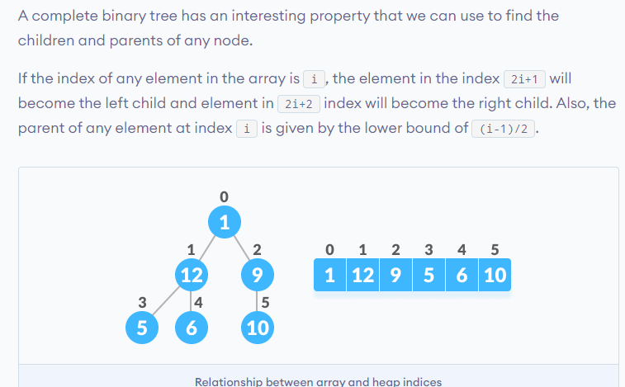
Array indices and heap elements

Slide 15

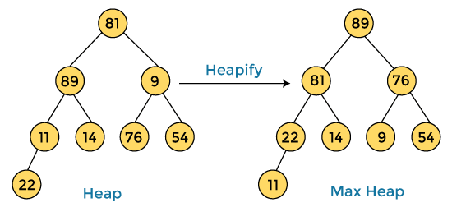

Slide 16

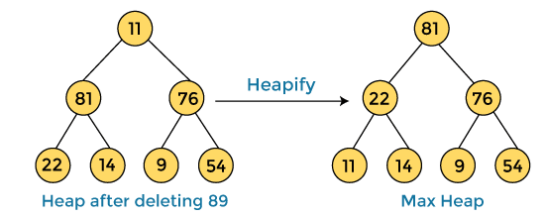


Slide 17
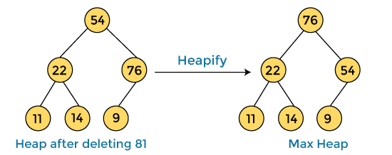


Slide 18
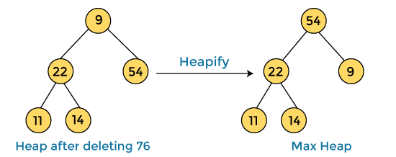


Slide 19
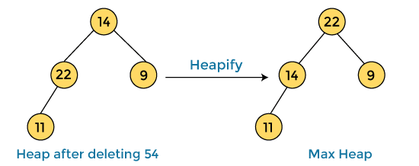


Slide 20



Slide 21



Slide 22



Slide 23



Slide 24
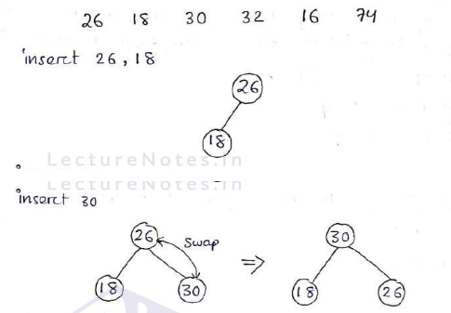
Constructing Max Heap

Slide 25

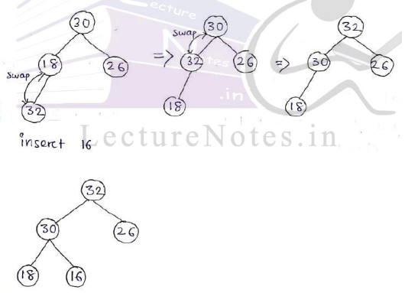
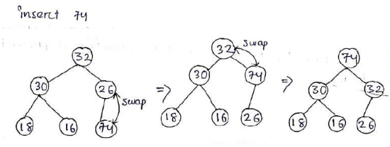
Constructing Max Heap

Slide 26
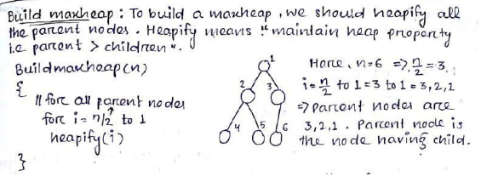
Building Max Heap

Slide 27
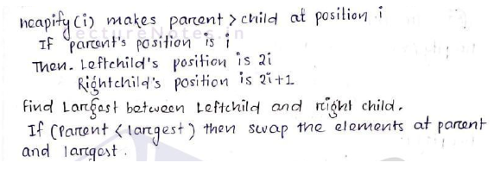

Slide 28
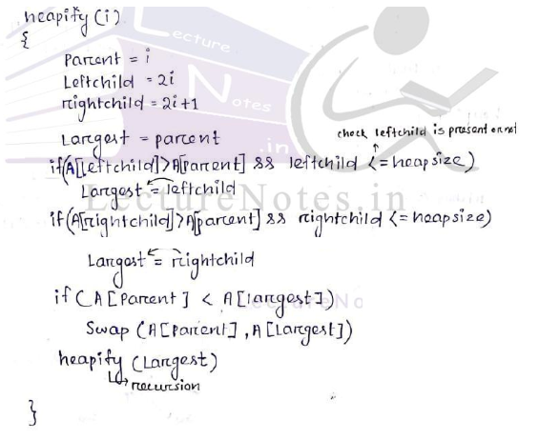

Slide 29
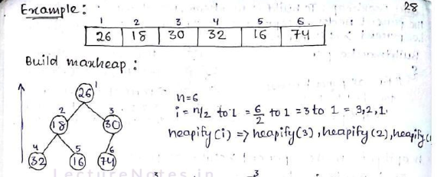

Slide 30
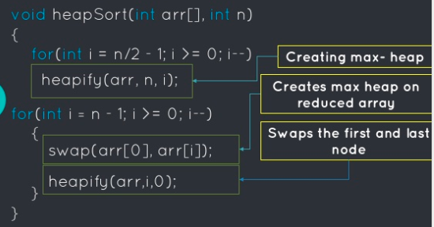
Algorithm - Heapsort

Slide 31
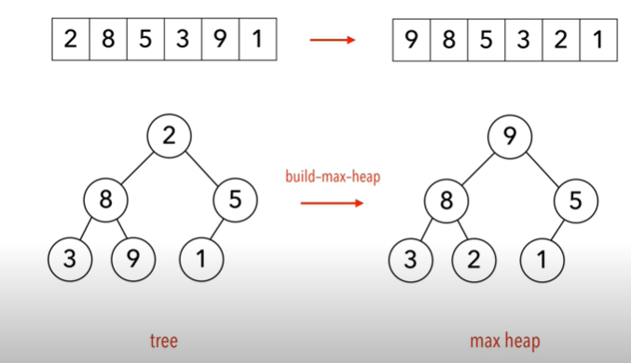

Slide 32
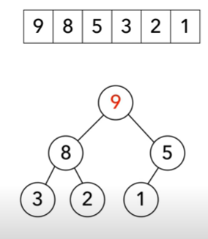
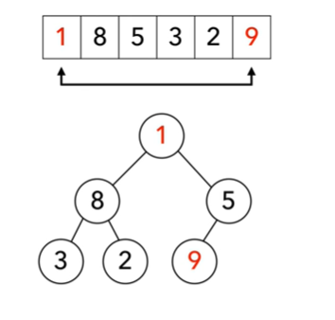
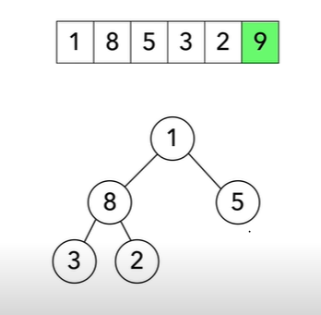
Swap the root with last element in the heap and remove the last element from the heap

Slide 33
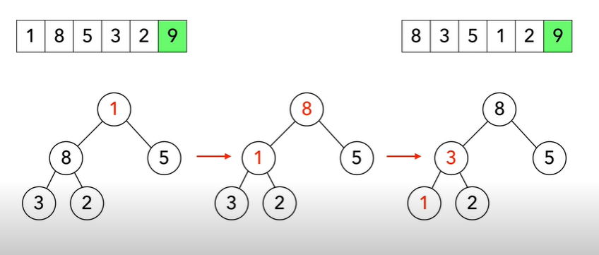
Heapify the tree

Slide 34
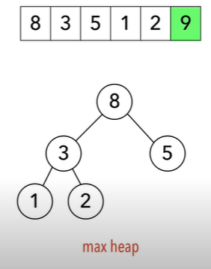

Slide 35
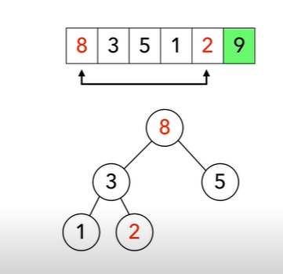
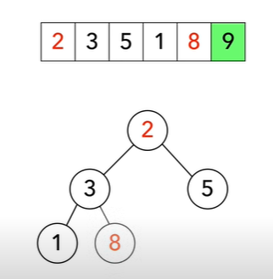
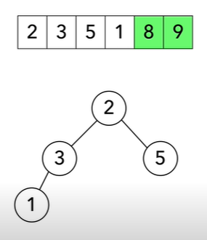

Slide 36
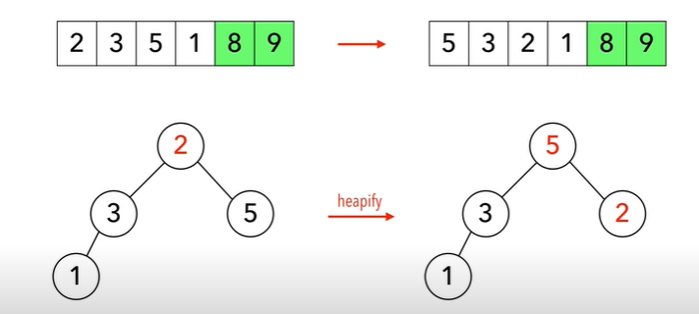

Slide 37
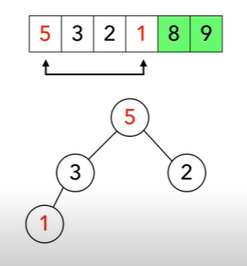
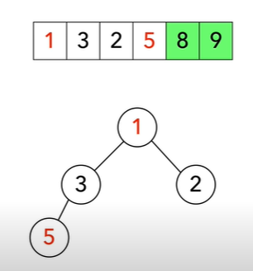
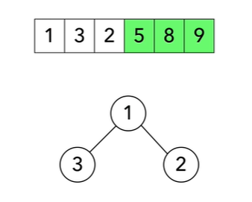

Slide 38
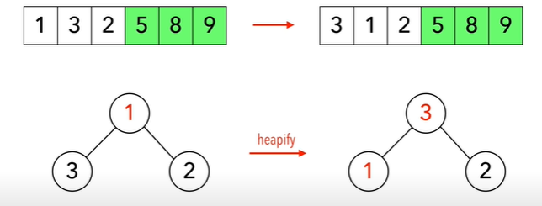

Slide 39
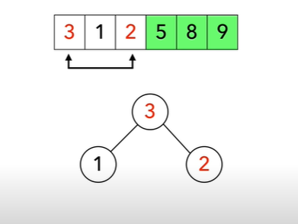
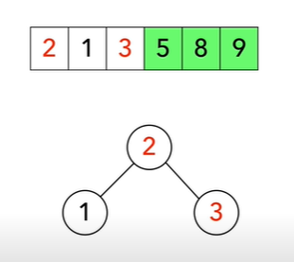
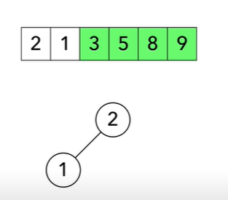

Slide 40
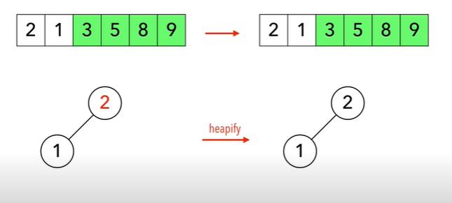

Slide 41
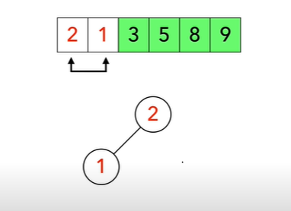
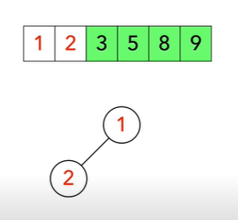
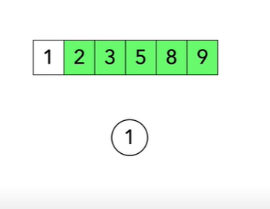

Slide 42
